Slide 1
Responsible Algorithms: Guiding Principles for Automated Decision-Making
Teresa Rodríguez de las Heras Ballell
Professor of Commercial Law, Universidad Carlos III de Madrid
Member of the EU Expert Groups on AI and Liability, on Platforms, and on B2B Data Sharing, EU Commission
teresa.rodriguezdelasheras@uc3m.es

Slide 2
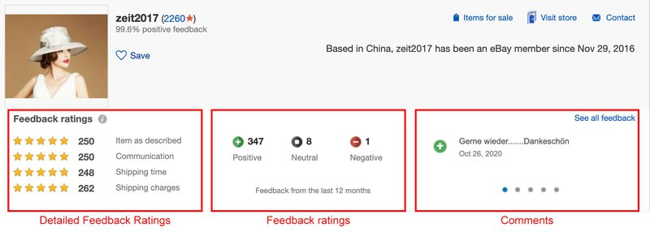
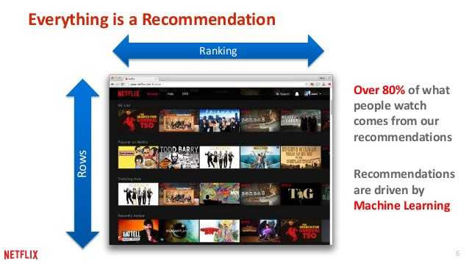

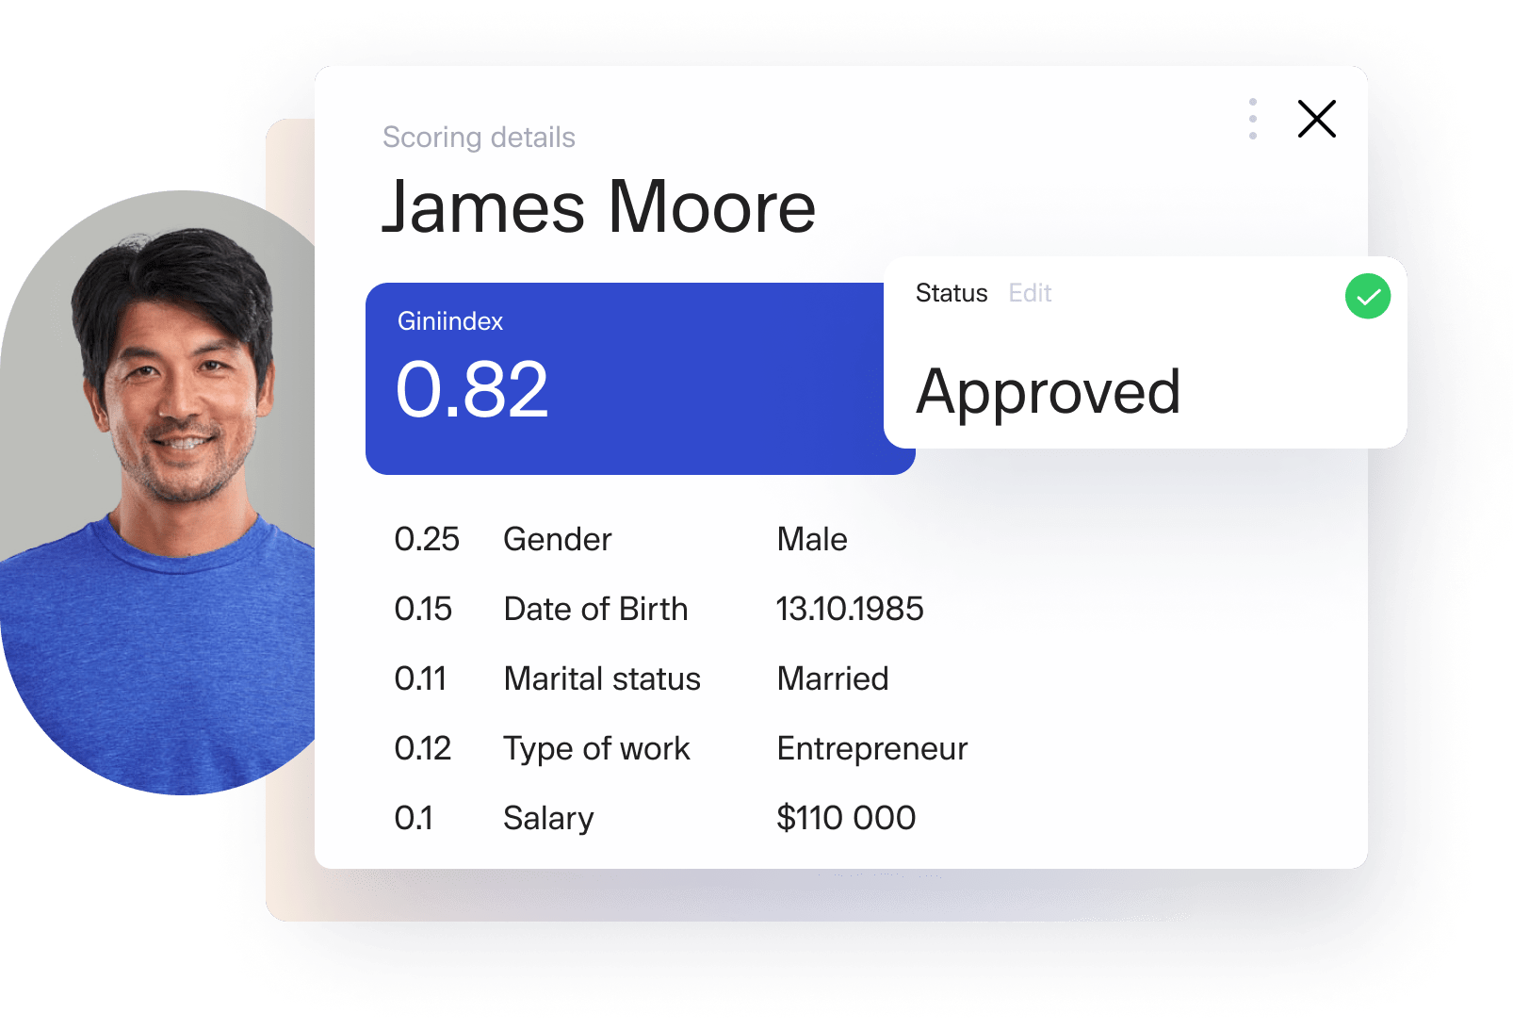

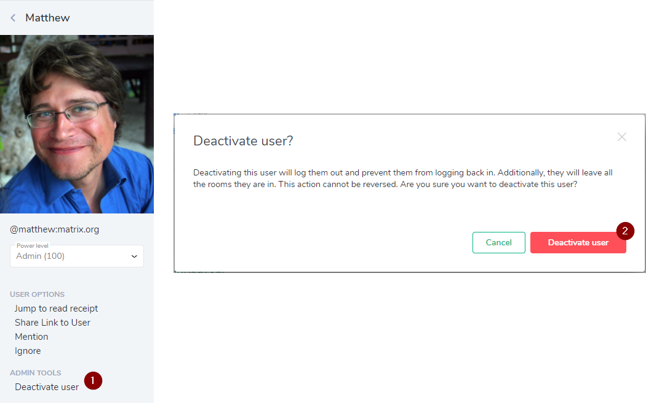


Slide 3
Are the decisions adopted by ADM or with the support of ADM valid and enforceable?
Are the decisions and actions made by ADM equivalent to human decisions and actions?
Can we simply apply the functional equivalence to declarations, agreements, performance actions, remedies, actions, settlements? Even if there is no human intervention in each and every action of the ADM?
…

Slide 4




Vendor / lessor
Provider
Algorithmic Agent /Delegate
Sellers – contracting parties
Consumer – Principal?
Operator

Slide 5
Are the decisions adopted by ADM or with the support of ADM valid and enforceable?
Are the decisions and actions made by ADM equivalent to human decisions and actions?
Can we simply apply the functional equivalence to declarations, agreements, performance actions, remedies, actions, settlements? Even if there is no human intervention in each and every action of the ADM?
…
To whom to attribute the legal effects
To whom to allocate liable for the damages caused
Are ADM-specific rules needed?
Legal/regulatory requirements: impact on private law

Slide 6
Key concepts and definitions
ADM
Actors
ADM-readiness test of existing rules
Principle-by-principle analysis
Future work

Slide 7
INPUTS
human-based inputs, machine-generated data, or interactions with the environment
PRE-DEFINED OBJECTIVES
TECHNIQUES
OUTPUTS
content moderation; rating, ranking, predictions or recommendations; online advertising; complaint handling and dispute resolution; tracing traders; algorithmic management in platforms; credit scoring; pricing, trading and investing,
or compliance

Slide 8
INPUTS
human-based inputs, machine-generated data, or interactions with the environment
PRODUCER
DATA PROVIDER
UPDATE PROVIDER
PRE-DEFINED OBJECTIVES
OPERATOR
Third parties
TECHNIQUES
ADM
Third parties
1
Third parties
OUTPUTS
content moderation; rating, ranking, predictions or recommendations; online advertising; complaint handling and dispute resolution; tracing traders; algorithmic management in platforms; credit scoring; pricing, trading and investing,
or compliance
INPUT for decision-making
AFFECTED PERSON/s
FINAL DECISION
2

Slide 9



Key concepts and definitions
ADM
Actors
ADM-readiness test of existing rules
EU Proposals
AI Liability Directive
Revised Directive on Defective Product
UNCITRAL WG IV on E-Commerce
Use of AI in international trade
ELI Algorithmic Project
ADM-readiness test on B2C

Slide 10
12 Guiding Principles
Title
Principle
Explanation
Illustration
.
DSA
GDPR
DMA
P2B Regulation
AI Act
…
Proposal of Directive on platform work

Slide 11
Guiding Principle 1: Law-compliant ADM.
Guiding Principle 2: Non-discrimination against ADM.
Guiding Principle 3: Attribution of decisions adopted by ADM
Guiding Principle 4: Disclosure that the decision-making is automated.
Guiding Principle 5: Traceable decisions.
Guiding Principle 6: Reasoned decisions
Guiding Principle 7: Allocation of risks to the operator
Guiding Principle 8: No limitations to the exercise of rights and access to justice
Guiding Principle 9: Human oversight/action
Guiding principles 10: Human review of significant decisions
Guiding Principle 11: Responsible ADM
Guiding Principle 12: Risk-based approach for ADM

Slide 12
Guiding Principle 1: Law-compliant ADM.
An operator that decides to use ADM for a particular purpose shall ensure that the design and the operation of the ADM are compliant with the laws applicable to an equivalent non-automated decision-making system
Guiding Principle 2: Non-discrimination against ADM.
As a general rule, ADM shall not be denied legal effect, validity or enforceability solely on the grounds that it is automated.
Guiding Principle 11: Responsible ADM
Operators should acknowledge the potential impact of the ADMs they employ on the socioeconomic context (democratic values, fundamental rights and liberties, human dignity, social cohesion, etc), and ensure that they use ADMs responsibly.

Slide 13
Illustration A. In a procurement system, bidders eligible for subsequent evaluation and interviews are shortlisted by automated means taking into consideration all relevant, objective, and quantifiable criteria requested in the tender. The shortlisting by automated means has the same legal effects as a human selection procedure.
Illustration B. Measures against misuse (DSA): does an evaluation ‘on a case-by-case basis’ exclude any form of automation? Traceability of traders (DSA): is the use of automated means for collecting, detecting errors, and/or verification of information provided by traders permitted?
Illustration C. DSA prevents online platforms from making decisions by internal complaint-handling systems solely on the basis of automated means. Consequently, the ADM can assist or support the decision, but the decision-making cannot be entirely and exclusively automated.
P1 Law-compliant
P2 Non-discrimination against ADM
P11 Responsible ADM

Slide 14
Guiding Principle 3: Attribution of decisions adopted by ADM
The decision adopted by ADM shall be attributed to the operator. The operator shall not deny the attribution of a decision solely on the grounds that it has been adopted by automated means.
Guiding Principle 7: Allocation of risks to the operator
The risks that the ADM may cause any harm or damage shall be allocated on the operator.

Slide 15
Guiding Principle 3: Attribution of decisions adopted by ADM
The decision adopted by ADM shall be attributed to the operator. The operator shall not deny the attribution of a decision solely on the grounds that it has been adopted by automated means.
Illustration A. An e-recruiting programme implemented by a service company ranks applicants, shortlists eligible candidates, and finally selects the chosen candidate who automatically receives an offer of employment. The recruitment decision is attributed to the company, as it is the operator.
Illustration B. A health insurance app implemented by an insurer enables the user to fill out a health questionnaire and to put forward an insurance proposal. The app assesses the eligibility conditions, calculates the premium, and accepts or rejects the insurance request. The decision to refuse the proposal or to conclude the insurance contract is attributed to the insurer operating the app. The insurer is the operator of the ADM and becomes the contracting party vis-à-vis the insured upon the acceptance of the insurance proposal.

Slide 16
DATA PROVIDER
DATA PROVIDER
DEVELOPER
No excuse to comply with and bear consequences on the sole grouns of automated means
OPERATOR
Third parties
ADM
Third parties
Attribution of legal effects – no repudiation
Third parties
relying on…
AFFECTED PERSON/s
Error

Slide 17
Guiding Principle 7: Allocation of risks to the operator
The risks that the ADM may cause any harm or damage shall be allocated on the operator.
Illustration A. A basic smart home system is installed in a house to control the heating, the shutters, the sunshades, and the sprinklers in the garden. The operator – provider of the smart home system and producer of all interconnected devices – provides the ADM controlling the entire system pre-installed in the central smart home hub. The ADM is based on weather predictions and data relating to temperature, sun hours, light, and rain provided by the sensors connected to the smart home system. For unknown reasons, the ADM instructs the system to unfurl the sunshades, open the shutters, and activate the sprinkles at full power on a very rainy day. At the end of the day, the garden, the porch, and the garage are completely flooded, the sunshades collapse due to the weight of the water, and the water starts to seep through the windows of the living room and the hall.
Illustration B. A university has implemented an algorithm-driven system for the delivery of mail and parcels on campus by a fleet of drones. The central system automatically classifies the received mail, assigns deliveries, and remotely activates and operates the drones up to destination. Should damage or personal injuries be caused by an accident, a collision with buildings or windows, or by a drone crashing in a garden, the university, as the operator, bears the risk, without prejudice to
the liability of the producer, if damage is caused by a defect of the product

Slide 18
PRODUCER
CONTRACTING PARTY
DISTRIBUTOR et al
Defect
Lack of conformity
Making available
Recourse
OPERATOR
Gatekeeper
Third parties
Control
Benefit
Third parties
Third parties
relying on…
ADM
AFFECTED PERSON/s

Slide 19
Guiding Principle 4: Disclosure that the decision-making is automated.
Unless it is obvious or unnecessary from the circumstances and the context of use or exempted by the law, it shall be disclosed that the decision is being adopted by automated means.
How the information is effectively disclosed depends upon the context of use and the circumstances surrounding the operation of the ADM.
continuous and recurrent use of ADM throughout the contractual relationship cycle
in other situations, the information needs to be disclosed at the moment that the affected person begins to interact with (or be affected by) the ADM if there was no prior contact between the parties or a long-term relationship that may render a previous disclosure feasible

Slide 20
Guiding Principle 4: Disclosure that the decision-making is automated.
(…)
Illustration A. A bank has implemented an ADM to assess the creditworthiness of credit applicants and screen eligible loan requests. The applicant has to fill out a questionnaire and submit their request via the bank app. The entire process is fully automated. The applicant is informed by way of a final decision of the refusal of the loan request or its acceptance. Only if loan conditions need to be discussed further will the applicant deal with bank staff. The applicant may not be aware that the submission and the screening process are fully automated. This process might not be sufficiently evident. Therefore, the bank has to ensure that the app alerts the applicant that the decision is made by ADM.
Illustration B. An electronic appliances store has installed a customer service robot at the main entrance of their premises. The robot processes basic complaints and settles claims at a primary stage. As the complaints are handled in situ, it is obvious for any affected person that it is interacting with an automated system and that a decision will be made by ADM
A case-by-case assessment would determine how evident it should be for an average user that the decision is automatically taken - location, interface design, interaction between the affected persons and ADM, types of decisions, context, transactional environment, targeted audience (minors, elderly people, etc).

Slide 21
Guiding Principle 5: Traceable decisions.
ADM shall be designed and operate in a manner that enables the traceability of any decision.
Guiding Principle 6: Reasoned decisions
The complexity, the opacity or the unpredictability of ADM is not a valid ground for rendering an unreasoned, unfounded or arbitrary decision.
Prerequisite
Technical possibility
Traceability is a decision-specific exercise, upon request or under certain circumstances
Beyond transparency
Reasonable: decisions, interests and rights, costs

Slide 22
Illustration
Facts: An insurer employs an app to screen eligible insureds for health insurance. The applicants fill in a questionnaire provided by the insurer via the app. Additionally, the app tracks the behaviour of the applicants in social media and predicts future health risks on the basis of certain patterns inferred from their digital activity.
Problem: A group of applicants whose requests have been refused by the app alleges that the denial of their requests is unfounded and arbitrary and ask for an explanation for the decision.
Principle: The operator (the insurer) should be in a position to trace the decisions refusing the requests and to provide a statement of reasons.
Consequences: The variety of data collected, the inaccuracy of such information taken from social media or the fact that the app is fully automated cannot lead to arbitrary decisions or to these being put forward as excuses not to provide reasons to the affected persons
.

Slide 23
Guiding Principle 8: No limitations to the exercise of rights and access to justice
Automation shall not prevent, hamper, or render unfeasible the exercise of rights and the access to justice by the affected persons. An alternative human-based route to exercise the rights should be available
Group of cases 1
Group of cases 2
the affected person can only exercise a right by resorting to an algorithmic process
the affected person is deprived of the possibility of exercising a right or access to justice solely on the grounds that the contested decision was made by ADM

Slide 24
Illustration 1
Facts: An insurer employs an app that manages the entire insurance cycle. Notification of events, declaration of risks or changes of relevant circumstances by the insured can solely be communicated to the insurer via the app and on a fully automated basis.
Problem: The insured attempts to notify the insurer of a relevant change in risk-reducing circumstances in order to benefit from an improvement of the economic conditions of the insurance policy by a corresponding reduction of the insurance premium.
Consequences: The app provides a form to communicate any change in the relevant circumstances. However, the form is very simple and merely offers the possibility for the insured to select one change among a list of pre-defined situations. The insured cannot communicate the change and there is no other way to contact the insurer.

Slide 25
Illustration 2
Facts: A platform for generating and sharing artistic digital content has developed a strict algorithm-driven content system to remove illegal content and content violating the platform’s policies. The content system detects inappropriate/illegal content and removes it automatically. If the system identifies more tan two infringements in one week, it immediately closes the content-publishing account and deletes all the user-generated content.
Problem: Once the account of the user (affected person) is removed, there is no access to the internal complainthandling process, dispute resolution mechanisms or the affected digital content. Thus, the user is totally defenceless, as there is no alternative way to challenge the decision other than through judicial action for restitution or compensation. Meanwhile, the user has lost all their posted digital content and has no reasonable means at their disposal to exercise their rights..
Principle: The effects of closing the account and deleting all the digital content may be considered excessive and undesired if the consequence is that the user has means of challenging the decision and defending
their rights before the closure and the removal are executed.

Slide 26
Guiding Principle 9: Human oversight/action
The operator shall ensure reasonable and proportionate human oversight over the operation of ADM taking into consideration the risks involved and the rights and legitimate interests potentially affected by the decision.
Guiding principles 10: Human review of significant decisions
Human review of selected significant decisions on the grounds of the relevance of the legal effects, the irreversibility of their consequences, or the seriousness of the impact on rights and legitimate interests shall be made available by the operator.

Slide 27
(beyond) GDPR | DSA | Directive on Platform Work
Articles 13(2)(f), 14(2)(g) and 15(1)(h) GDPR | Statement of reasons | Written statement of reasons for significant decisions
‘meaningful information about the logic’ involved in ADM, and ‘the significance and envisaged consequences of such’ automated processing | ‘as precise and specific as reasonably possible’ …And necessary | decisions likely to significantly affect a person’s legal or contractual status, to impact their rights, or restrict, suspend or terminate the affected person’s account –limitation or the termination of the exercise of rights – should be reasoned.

Slide 28
Future work
International Principles for ADM in international trade
Responsible Algorithms
ADM-readiness test in consumer contracts

Slide 29
Teresa Rodríguez de las Heras Ballell
Professor of Commercial Law, Universidad Carlos III de Madrid
Member of the EU Expert Groups on AI and Liability, on Platforms, and on B2B Data Sharing, EU Commission
teresa.rodriguezdelasheras@uc3m.es

