Slide 1

Cambridge University
19 October 2021

Slide 2
Core Thesis
Capital is coded in law
Capital = wealth generating asset
Law = Institutionalized means of coercion

Slide 3
Capital’s
Attributes
(3/4)
Priority
Ranking
Durability
Extension in time
Universality
Extension in space
Convertibility
Lock-in past gains

Slide 4
Legal Modules
Property Law
Collateral Law
Trust Law
Corporate Law
Bankruptcy Law
Contract Law

Slide 5
Illustrations (Book):
The coding of
Land
Firms
Debt
Know-how

Slide 6
Conception of Law
The modern nation state has centralized the means of coercion (Max Weber)
It does not follow that access to the means of coercion is also centralized
The legal system institutionalizes access to the means of coercion: Who, how, for what purpose

Slide 7
  Private v. Private
  Public v. Private
Civil Court
Criminal Court
Legal Access Channels
Admin./ Constitut.
Court
Policing/
Regulation
  Private v. Public
  Public v. Private

Slide 8
Private v. Private
Standing rules
Natural or legal persons
Permissible claims
Property Rights
Injury to person, assets,…
Available
Remedies
Property rules
Liability rules
Contracts
Individuals or collectives

Slide 9
What is Property?
Use
Expectations
Probability of Realizing Expectations
Land
Going Concern
Financial Assets

Slide 10
Piketty, C 21st Century, 2014

Slide 11
Bernard Rudden (1994)
The traditional concepts of the common law of property were created for and by the ruling classes at a time when the bulk of their capital was land. Nowadays the great wealth lies in stocks, shares, bonds and the like, and is not just movable but mobile, crossing oceans at the touch of a key-pad in the search for a fiscal utopia. (…)
In terms of legal theory and technique, however, there has been a profound if little discussed evolution by which the concepts originally devised for real property have been detached from their original object, only to survive and flourish as a means of handling abstract value. The feudal calculus lives and breeds, but its habitat is wealth not land.”

Slide 12
Law is malleable
“The working rules of society” (Veblen)
Major/Explicit change
Legislation
New Precedent
Incremental change
Drift, conversion, etc. (Thelen et al.)
Interpretation, Analogy, Gap-filling
(Expected) recognition by courts

Slide 13
Expanding Assets
Tangible objects
Commodification, assetization, coding
Intangibles
Originate in law
Expansion through legal engineering
Examples
Intellectual property rights
Financial Assets/Structured Finance

Slide 14
Expanding Private Access to Coercion
Private v. Private
Choice of Law
Choose from among different legal orders
Choice of Forum
Choose among courts located in different jurisdictions
Private dispute resolution
Option to use private arbitration
Universal Execution
Assurance of coercive law enforcement even when options exercised
From contract to corporate and property rights

Slide 15
Legal Foundations
Domestic conflict of laws rules/International Private Law
Domestic law on arbitration (recognition and enforcement)
International Conventions on choice of law
International treaties and model laws on arbitration

Slide 16

The Masters of the Code
Knowledge of the law
Mastery of the law’s (relative) malleability
Ability to translate economic interests into legal categories
Ability to repurpose legal categories for economic interests
Persuasiveness
Creativity
Elastic ethics

Slide 17
Global Financial Centers =
Global Coding Centers

Slide 18
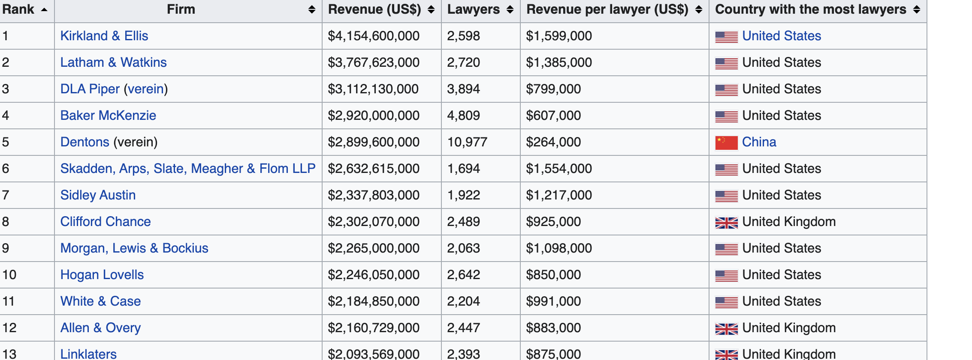
Global Law Firms (2019)

Slide 19
Concluding Thoughts
It takes a legal system (or two) to code capital
An economy based on private initiative depends on adaptive/malleable law
Property Law has long been a prerogative of the territorial nation state
  Location – yet, not all assets have a location
  Digital economy in tension with analogue property rights
  Globalization of intellectual property rights (TRIPS, BITs etc.)
Expansive protection of private property rights constrains states
  No expropriation w/o fair market compensation
  Protection of expectation affects future change
Strategic interventions using the playbook of capital

Slide 20
Thank you

