Slide 1
Redefining stewardship for the 21st Century:
Claudia Chapman
3 March 2020

Slide 2
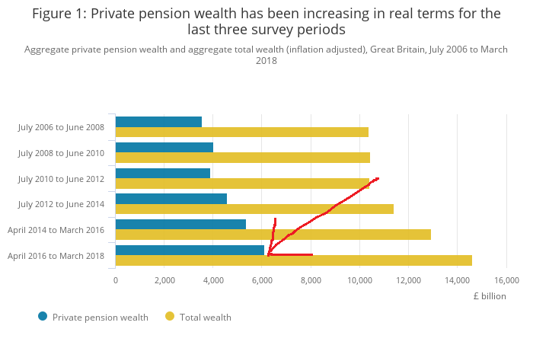
UK Pension Wealth
Source: ONS – Wealth and Assets Survey

Slide 3


Slide 4
2012
"Stewardship aims to promote the long term success of companies in such a way that the ultimate providers of capital also prosper. Effective stewardship benefits companies, investors and the economy as a whole."

Slide 5
History
2005
ISC
2007/8
Financial crisis
2010
Walker Review
2012
Kay Review
2015
Tiering
2019
Consult & new
Code
FRC

Slide 6
Issues

Slide 7
Expectations

Slide 8

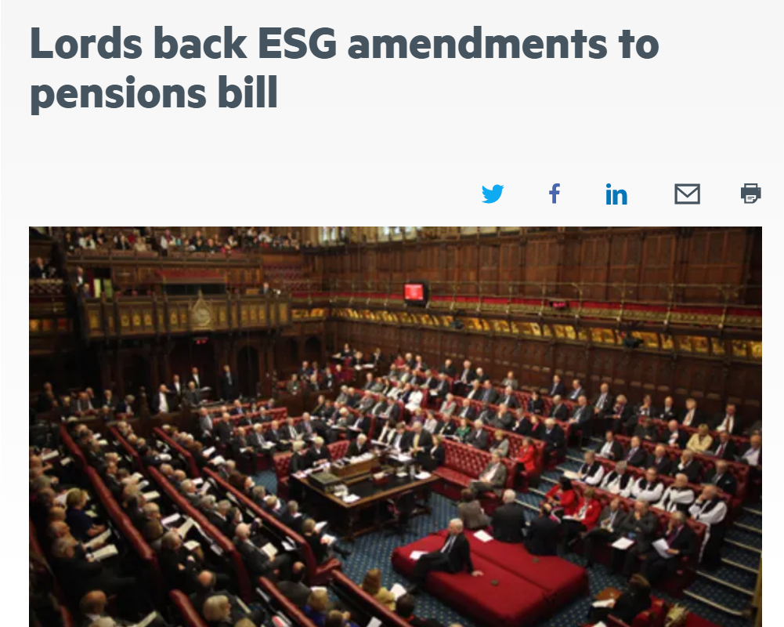

Slide 9
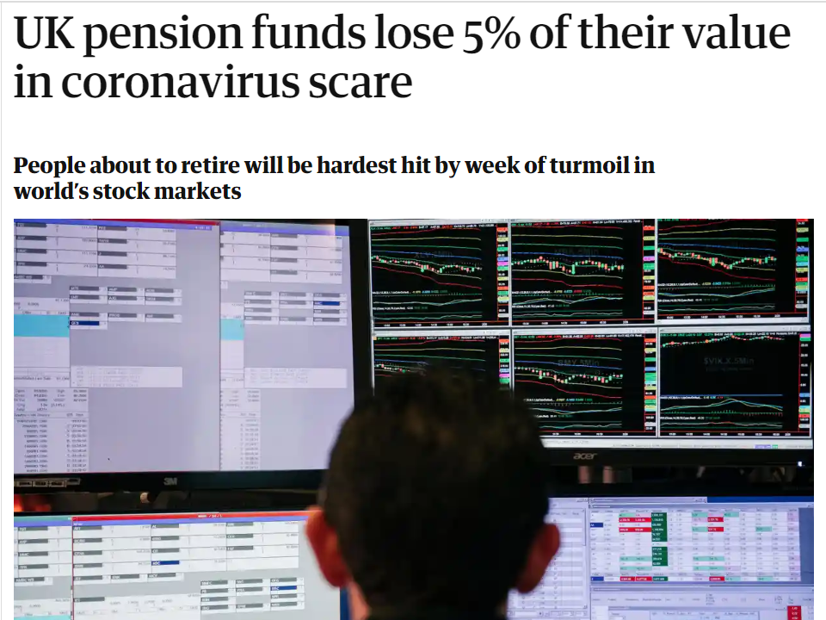

Slide 10
Expansion

Slide 11
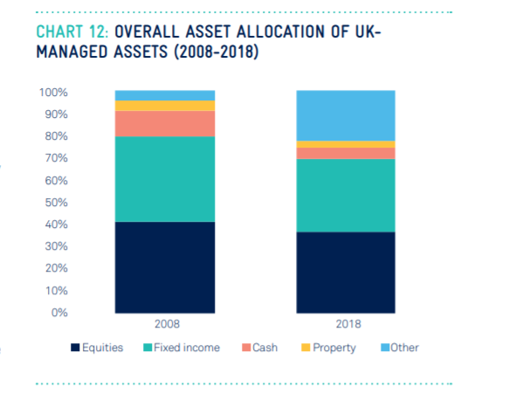

Slide 12
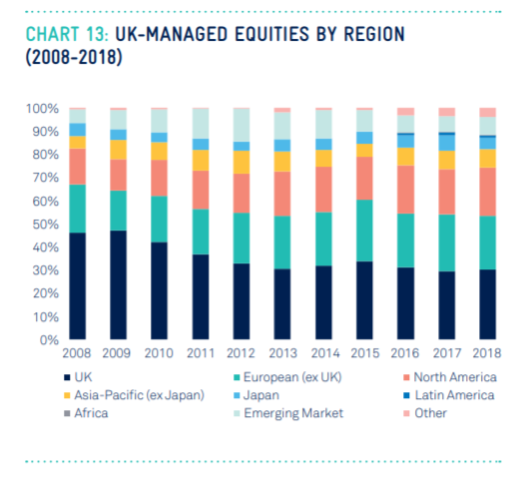

Slide 13
Effectiveness

Slide 14
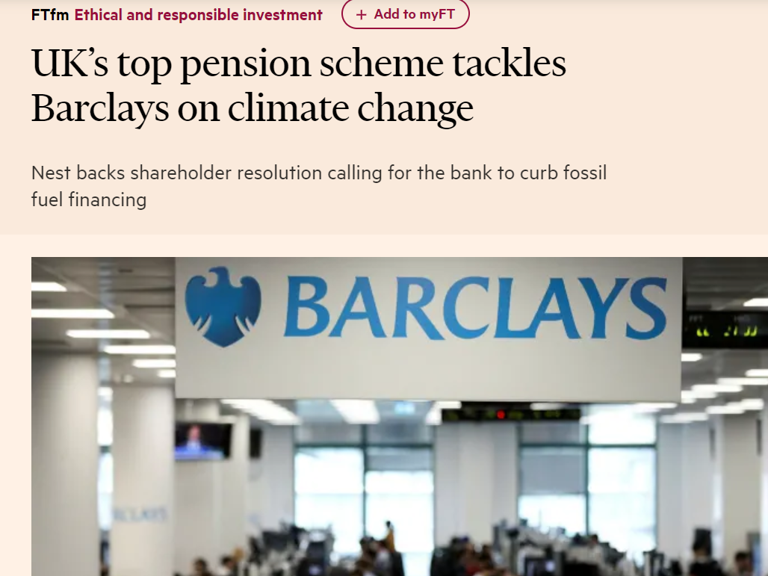

Slide 15
2020 definition
"Stewardship is the responsible allocation, management and oversight of capital to create long-term value for clients and beneficiaries leading to sustainable benefits for the economy, the environment and society."

Slide 16
Discussion and questions

